Slide 1
第六讲 深入理解类

Slide 2
内容
Class Members
Instance Class Members
Static Class Member
Constants
Properties
Constructors and Destructors
The readonly Modifier
The this Keyword
Indexers
Access Modifiers on Accessors
Partial Classes

Slide 3
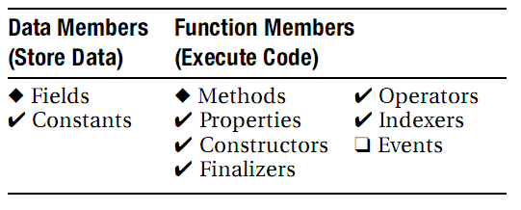
Class Members类成员

Slide 4
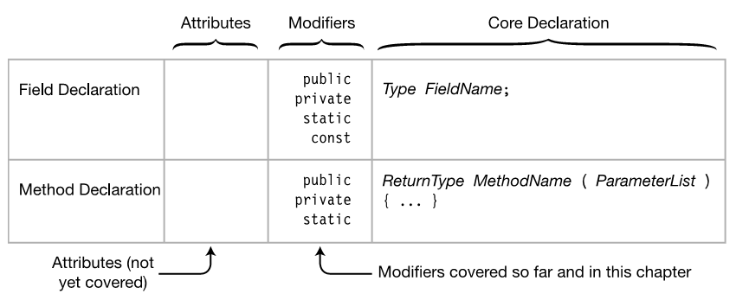
Order of Member Modifiers
成员修饰符的顺序

Slide 5
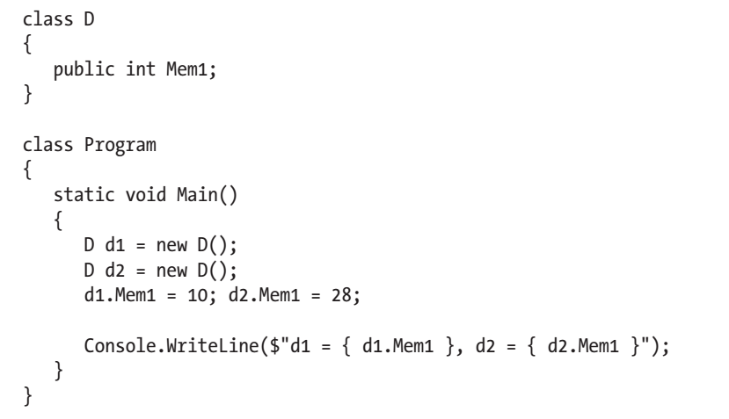
Instance Class Members
实例类成员
Demo

Slide 6
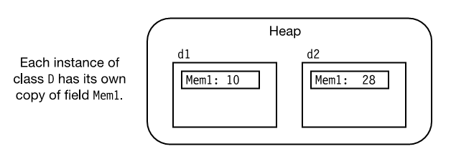

Slide 7
Static Class Member
Static Fields
Static Function Members
Other Static Class Member Types

Slide 8
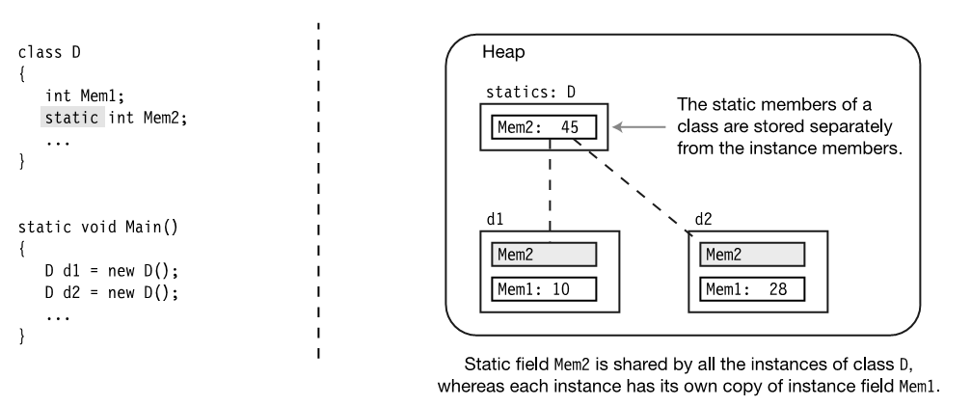
Static Fields静态字段

Slide 9
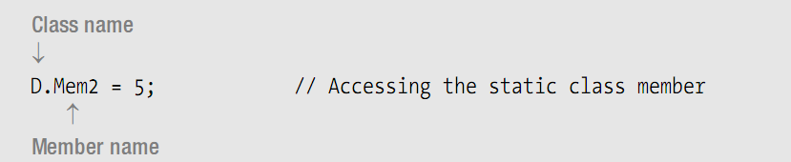
Accessing Static Members from Outside the Class从类的外部访问静态成员

Slide 10
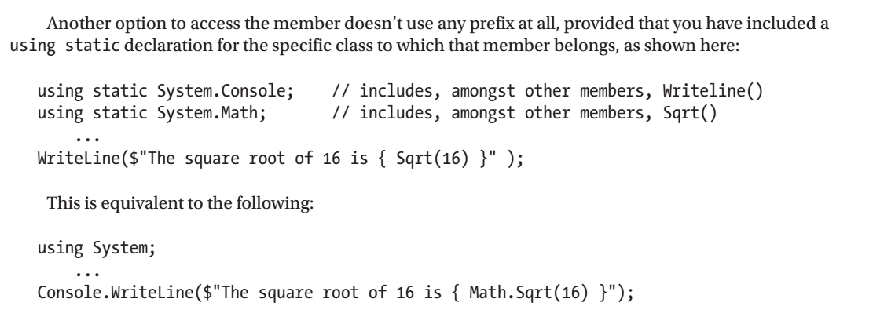

Slide 11
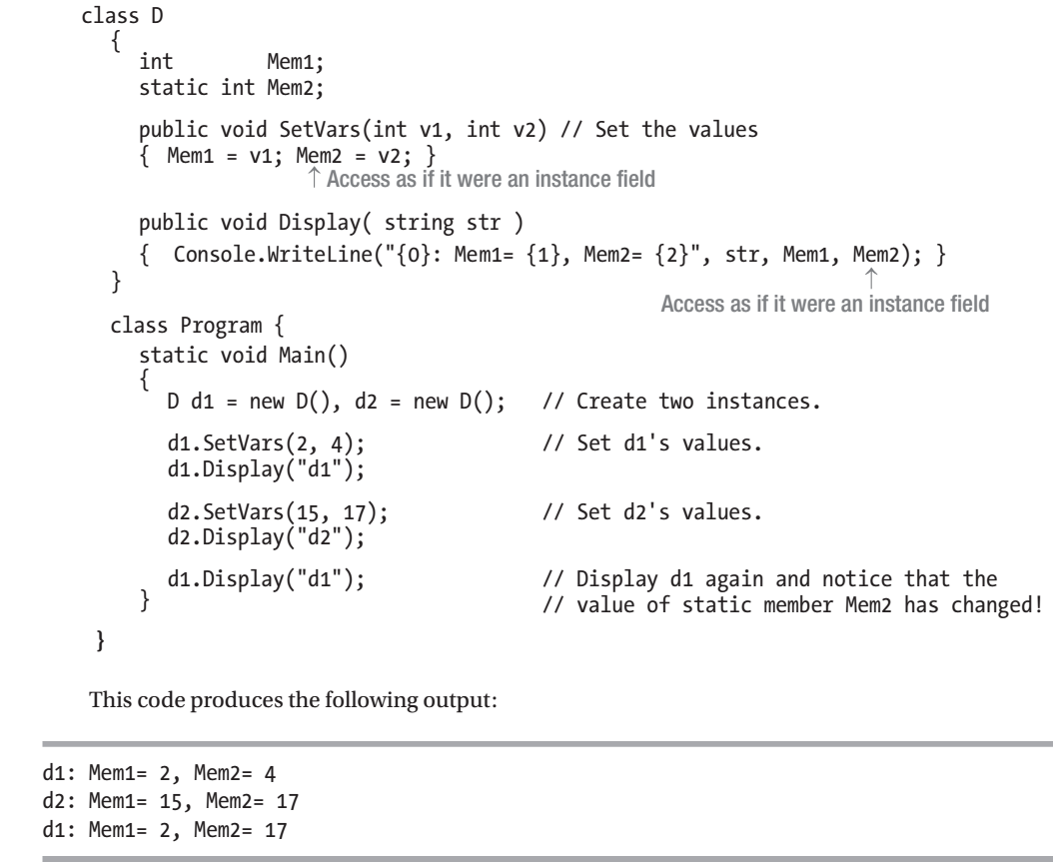
Static Field
Demo

Slide 12
Lifetimes of Static Members
静态成员的生存期
Instance members come into existence when the instance is created and go out of existence when the instance is destroyed.
Static members, however, exist and are accessible even if there are no instances of the class.

Slide 13
Static Function Members
静态函数成员
Static function members, like static fields, are independent of any class instance. Even if there are no instances of a class, you can still call a static method.
Static function members cannot access instance members. They can, however, access other static members.

Slide 14
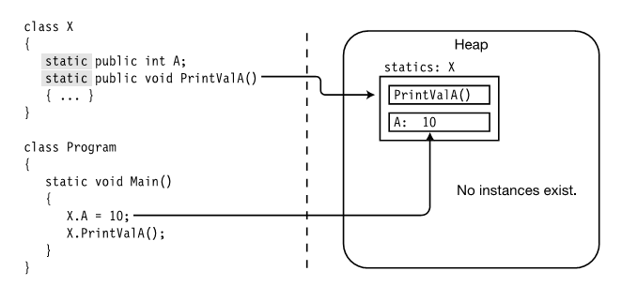
DEMO

Slide 15
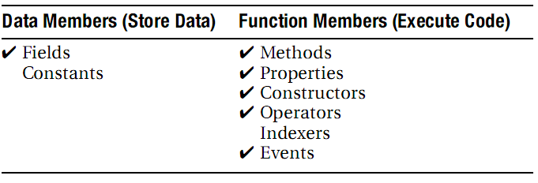
Other Static Class Member Types
其他静态类成员类型
Class Member Types That Can Be Declared Static

Slide 16
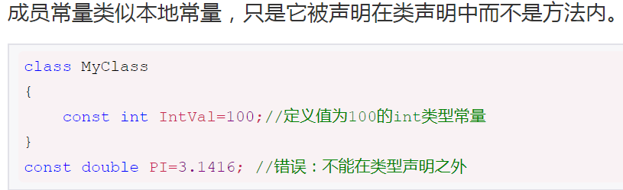
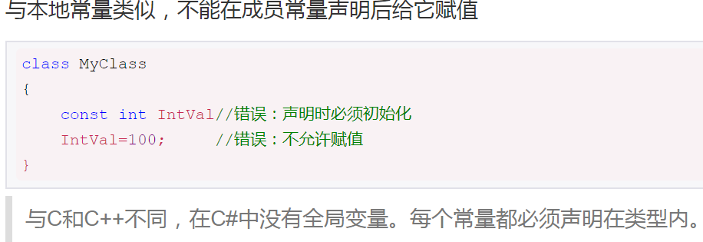
Member Constants
成员常量
Demo

Slide 17
常量与静态量
Constants Are Like Statics.
Unlike actual statics, however, constants do not have their own storage locations, and are substituted in by the compiler at compile time in a manner similar to #define values in C and C++.
Although a constant member acts like a static, you cannot declare a constant as static.

Slide 18
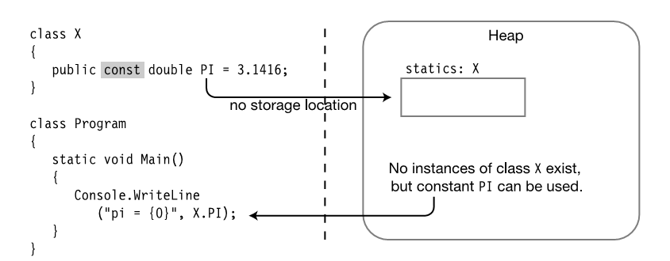

Slide 19
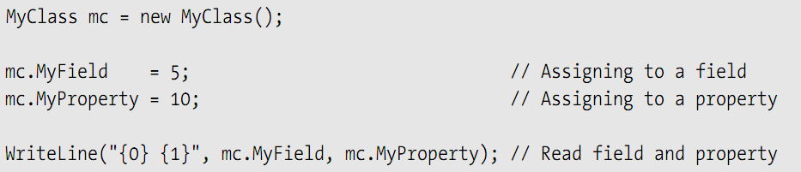
Properties
属性
A property is a member that represents an item of data in a class instance or class.
Using a property appears very much like writing to, or reading from, a field.

Slide 20
Properties
A property, like a field, has the following characteristics:
  It is a named class member.
  It has a type.
  It can be assigned to and read from.
Unlike a field, however, a property is a function member.
  It does not allocate memory for data storage!
  It executes code.

Slide 21
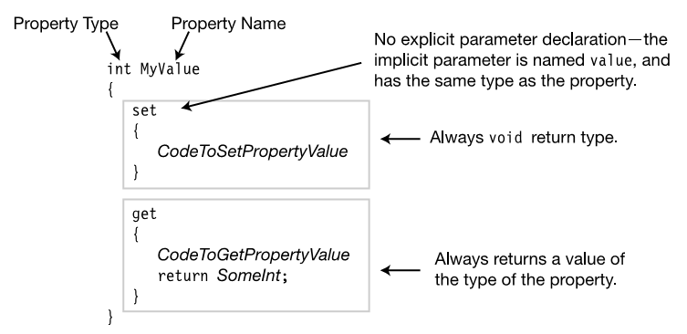
Properties

Slide 22
Properties and Associated Fields
属性和关联字段
A common practice is to encapsulate a field in a class by declaring it private, and declaring a public property to give controlled access to the field from outside the class.
The field associated with a property is often called the backing field or backing store.

Slide 23
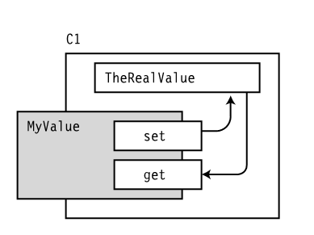
Properties and Associated Fields

Slide 24
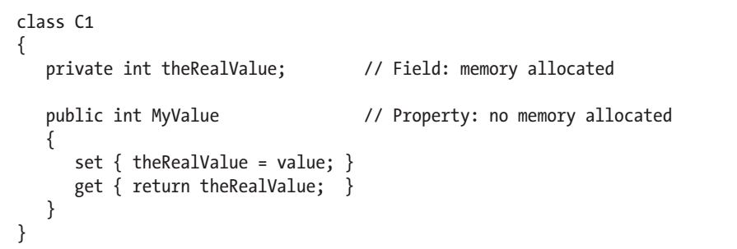
Properties and Associated Fields
Demo

Slide 25
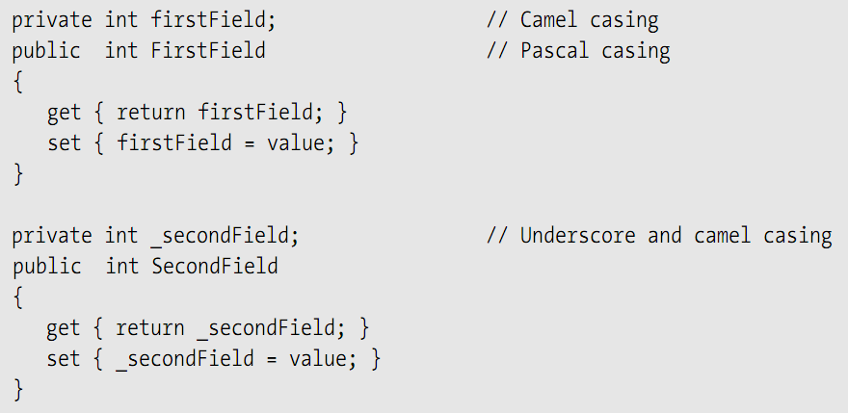
Properties and Associated Fields

Slide 26
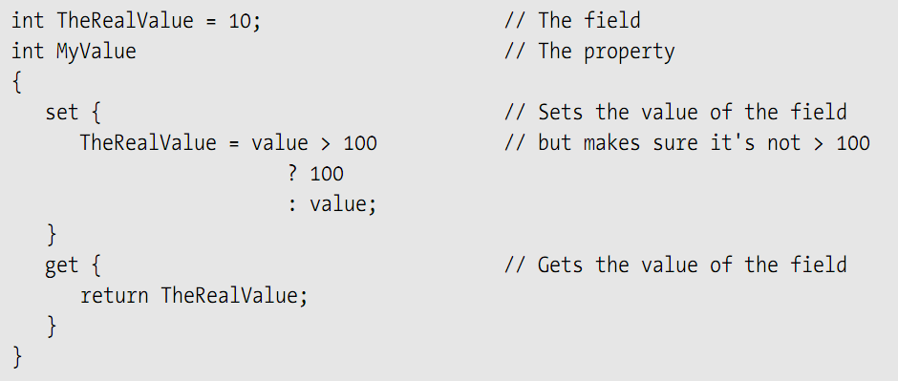
Performing Other Calculations
执行其他计算

Slide 27
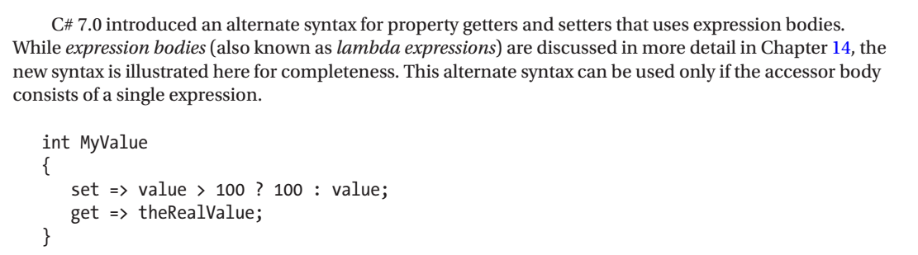

Slide 28
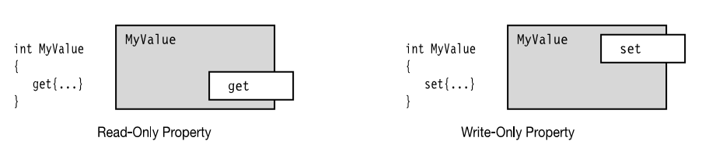
Read-Only and Write-Only Properties
只读和只写属性

Slide 29
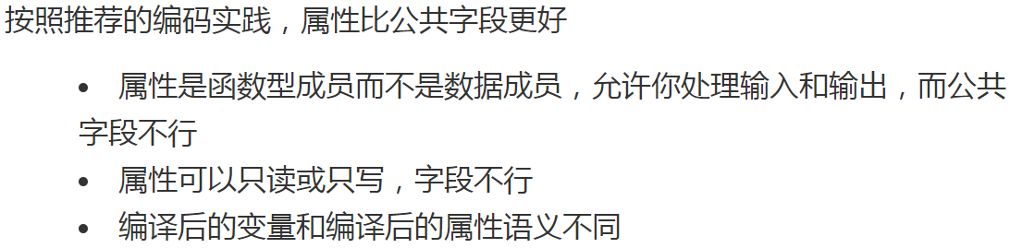
Properties vs. Public Fields
属性与公共字段
Since properties are functional members as opposed to data members, they allow you to process the input and output, which you can’t do with public fields.
The semantics of a compiled variable and a compiled property are different.

Slide 30
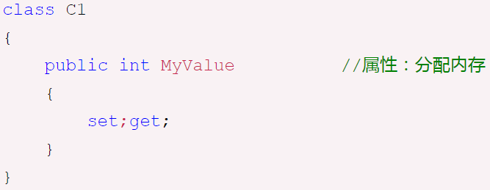
Automatically Implemented Properties
自动实现属性
Because properties are so often associated with backing fields, C# 3.0 has added automatically implemented properties, or auto-implemented properties, which allow you to just declare the property, without declaring a backing field.

Slide 31
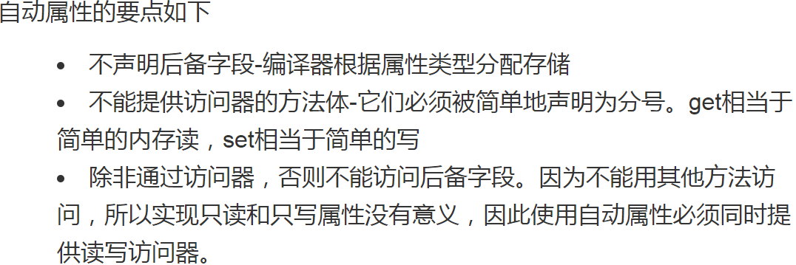
Automatically Implemented Properties
Demo

Slide 32
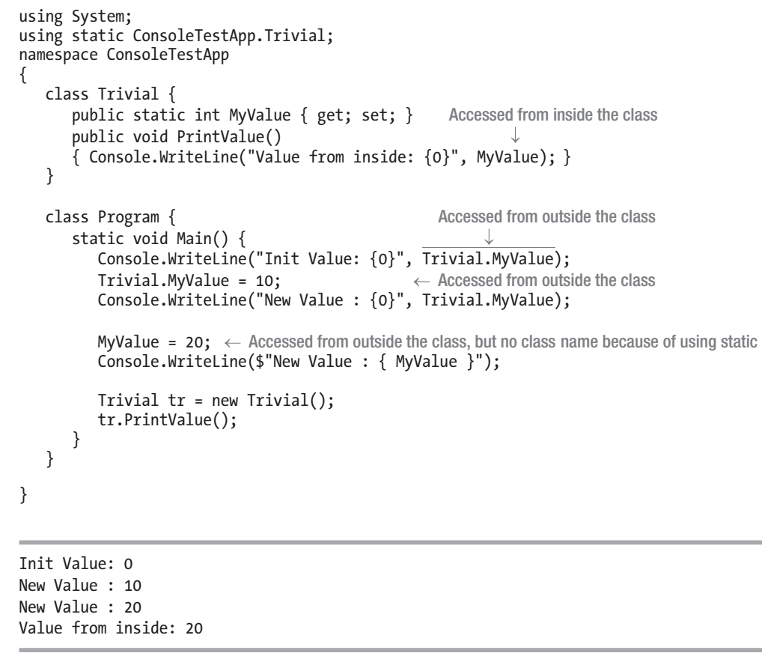
Static Properties
静态属性
like all static members
Demo

Slide 33
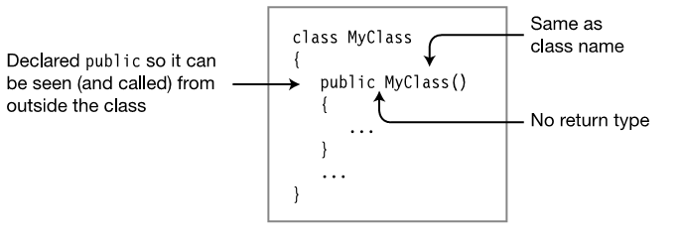
Constructors and Destructors
Instance Constructors实例构造函数

Slide 34
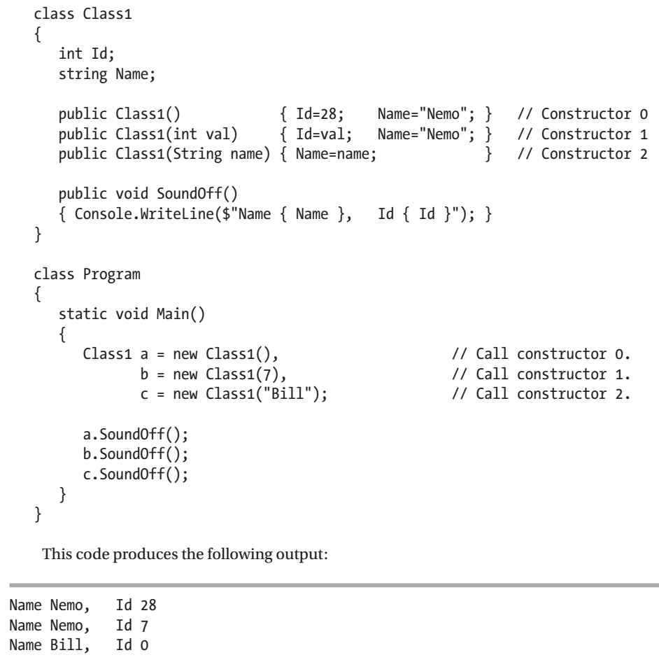
Constructors with Parameters
带参数的构造函数
Demo

Slide 35
Default Constructors
默认构造函数
If no instance constructor is explicitly supplied in the class declaration, then the compiler supplies an implicit, default constructor, which has the following characteristics:
  It takes no parameters.
  It has an empty body.
If the programmer defines one or more constructors, then the compiler will not define a default constructors for the class.
要养成编写无参构造器的良好习惯

Slide 36
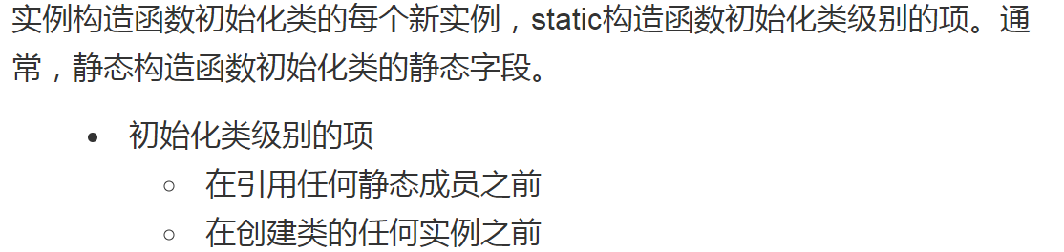
Static Constructors
静态构造函数
Generally, static constructors initialize the static fields of the class.
You cannot explicitly call static constructors from your program. They are called automatically by the system

Slide 37
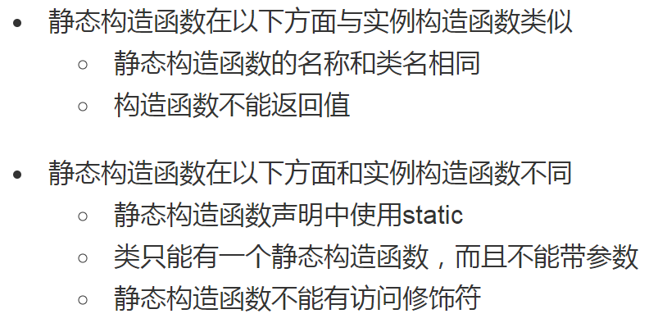

Slide 38
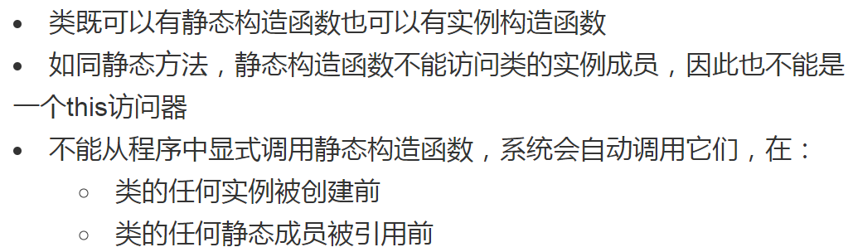
Static Constructors
Demo

Slide 39
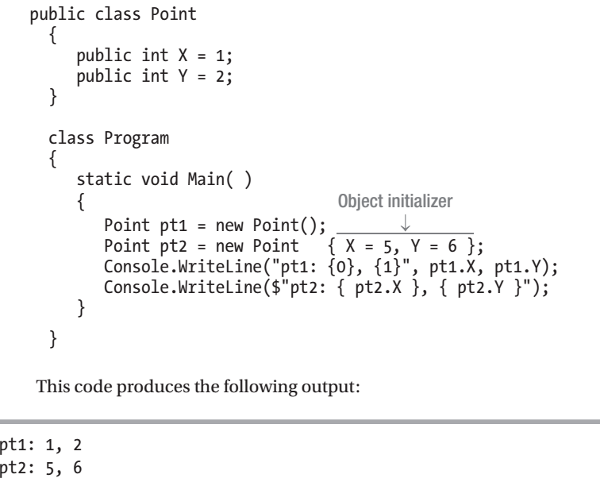
Object Initializers

Slide 40
Destructors
析构函数
对象的生存期
垃圾回收机制
Finalize的操作
Dispose模式
using语句

Slide 41
对象的生存期
值类型:stack
  被弹出就销毁，内存被回收
引用类型：heap
  同一个对象可以拥有无限数量的引用，CLR会跟踪所有这些引用，直到所有引用消失之后才销毁这个对象，内存被归还给heap。
  这样的过程称为垃圾回收。

Slide 42
垃圾回收(Garbage Collection)机制
B
托管堆
D
A
E
H
J
K
M
N
P
R
G
第2代
第1代
第0代
C
I
F
A
L
O

Slide 43
垃圾回收(Garbage Collection)机制
托管堆
第2代
第1代
第0代
10M
2M
256K

Slide 44
释放非托管资源
对于您的应用程序创建的大多数对象，可以依靠 .NET Framework 的垃圾回收器隐式地执行所有必要的内存管理任务。
但是，在您创建封装非托管资源的对象时，当您在应用程序中使用完这些非托管资源之后，您必须显式地释放它们。最常见的一类非托管资源就是包装操作系统资源的对象，例如文件、窗口或网络连接。虽然垃圾回收器可以跟踪封装非托管资源的对象的生存期，但它不了解具体如何清理这些资源。

Slide 45
释放非托管资源的2种方法
手动释放
自动释放
Dispose()方法或Close()方法
Finalize()方法
非托管资源的释放

Slide 46
释放非托管资源-- Finalize的操作
对于封装非托管资源的对象，.NET Framework 提供 object.Finalize 方法，它允许对象在垃圾回收器回收该对象使用的内存时适当清理其非托管资源。
析构函数其实就是object.Finalize 方法。
Demo

Slide 47
Finalize的操作
B
G
托管堆
A
C
D
E
F
H
I
J
E
I
J
垃圾回收器
C
F
Finalization list
FReachable queue
实现了析构函数的实例会在这List中有个引用
高优先级线程，空时睡眠，非空唤醒

Slide 48
Finalize的操作
托管堆
A
B
C
D
E
F
G
H
I
J
垃圾回收器
C
E
F
I
J
E
I
J
Finalization list
FReachable queue
当系统判断E,I,J三个实现了析构函数的实例需要释放的时候，三个实例在list中的引用会被迁移到这个queue中，然后伺机释放E,I,J

Slide 49
慎用析构函数
实现 Finalize 方法或析构函数对性能可能会有负面影响，因此应避免不必要地使用它们。用 Finalize方法回收对象使用的内存需要至少两次垃圾回收。当垃圾回收器执行回收时，它只回收没有终结器的不可访问对象的内存。这时，它不能回收具有终结器的不可访问对象。它改为将这些对象的项从终止队列中移除并将它们放置在标为准备终止的对象列表中。该列表中的项指向托管堆中准备被调用其终止代码的对象。垃圾回收器为此列表中的对象调用 Finalize 方法，然后，将这些项从列表中移除。后来的垃圾回收将确定终止的对象确实是垃圾，因为标为准备终止对象的列表中的项不再指向它们。在后来的垃圾回收中，实际上回收了对象的内存。

Slide 50
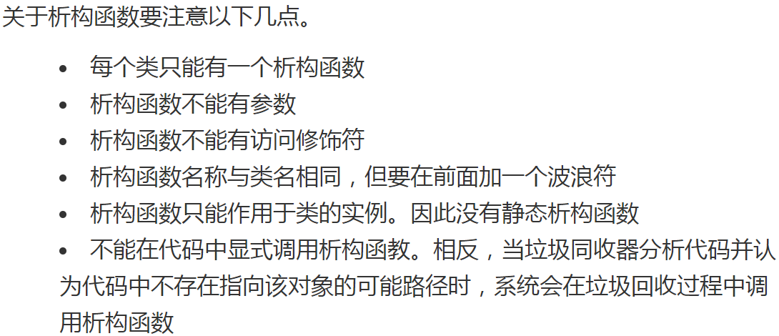

Slide 51
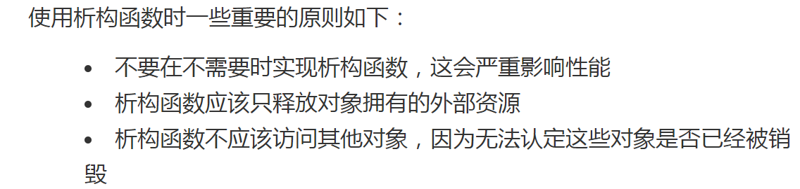

Slide 52
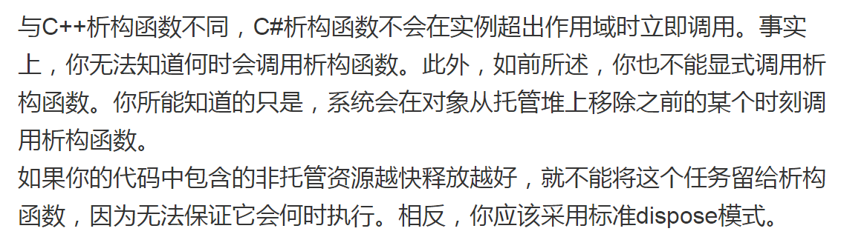
Dispose模式

Slide 53
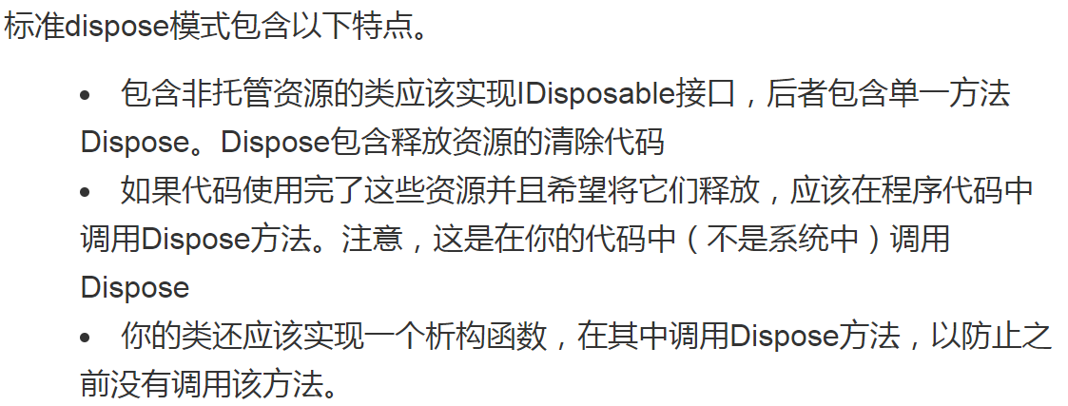

Slide 54
IDisposable接口
public interface IDisposable
{
void Dispose();
}

Slide 55
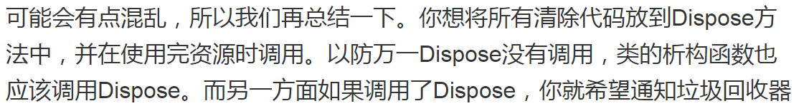
为何使用Dispose模式

Slide 56
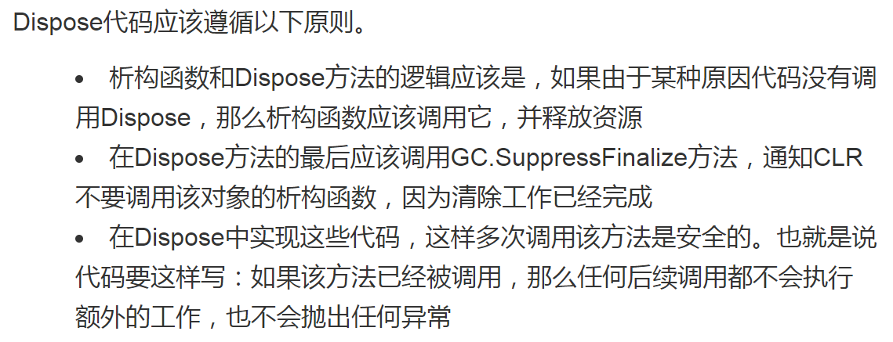

Slide 57
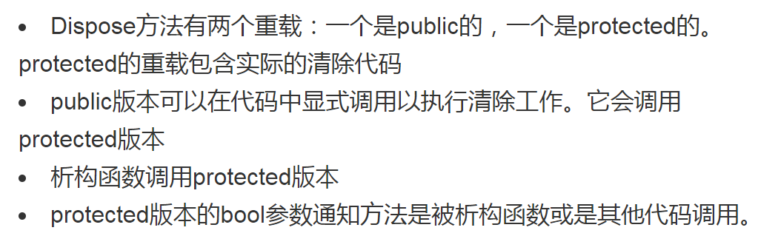
Dispose模式(微软推荐)代码要点

Slide 58
Dispose模式(微软推荐)
Dispose()
Close()
Finalize()
Dispose(bool disposing)
disposing==true
disposing==false
特指引用对象包含非托管资源，然后释放
释放托管资源
释放非托管资源
非托管资源的释放
阻止finalize操作

Slide 59
Dispose模式
Demo

Slide 60
using语句
using 语句确保调用 Dispose，即使在调用对象上的方法时发生异常也是如此。
通过将对象放入 try 块中，并在调用 finally 块中的 Dispose，可以获得相同的结果；实际上，这就是编译器转换 using 语句的方式。

Slide 61
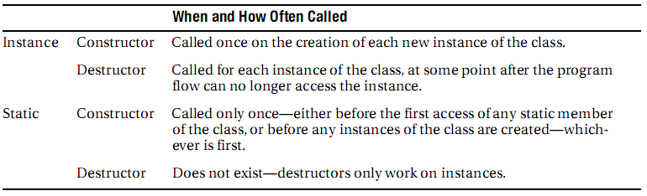
Comparing Constructors and Destructors

Slide 62
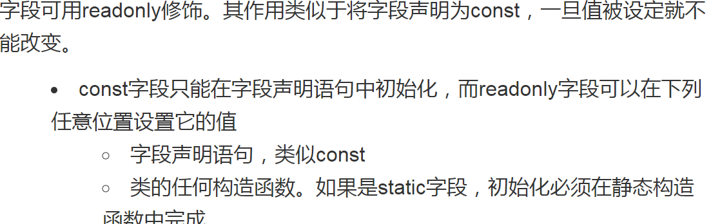
The readonly Modifier readonly修饰符
once the value is set, it cannot be changed.
While the value of a const field must be determinable at compile time, the value of a readonly field can be determined at run time.
allows you to set different values in different constructors
Unlike a const
  can be either an instance field or a static field.
  has a storage location in memory
?比较一下：static,const,readonly

Slide 63
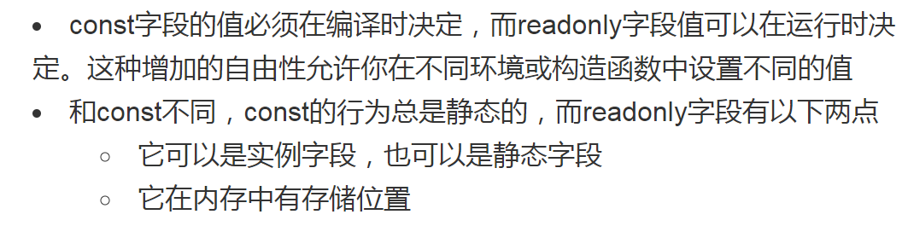
?比较一下：static,const,readonly
?比较一下：static,const,readonly

Slide 64
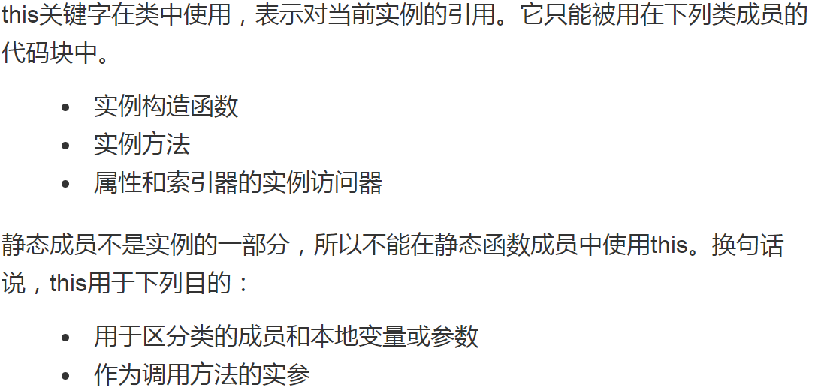
The this Keyword
the this keyword, used in a class, is a reference to the current instance.
since static members are not part of an instance, you cannot use the this keyword inside the code of any static function member

Slide 65
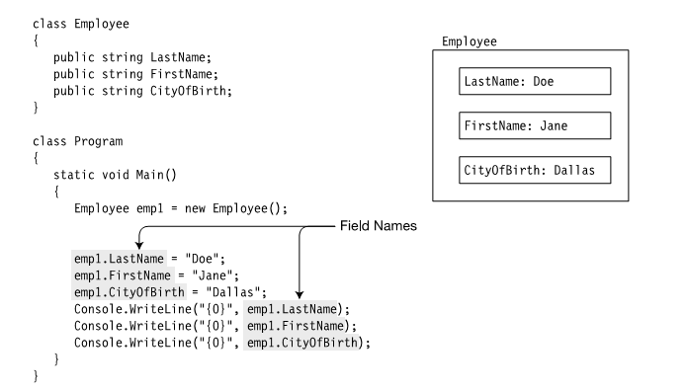
Indexers
索引器

Slide 66
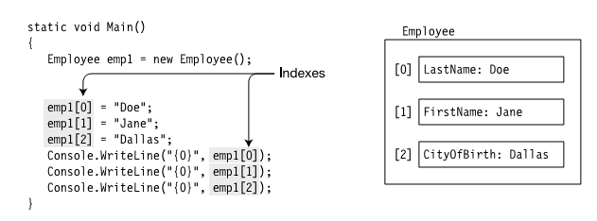
Using indexed fields
What Is an Indexer?

Slide 67
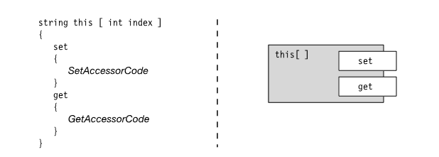
What Is an Indexer?
An indexer is a set of get and set accessors, similar to those of properties.

Slide 68
Indexers and Properties
Like a property, an indexer does not allocate memory for storage.
An indexer is usually accessing multiple data members.
Indexers are always instance members; hence, an indexer cannot be declared static.
可以认为索引器是为类的多个数据成员提供get、set属性。通过索引器，可以在许多可能的数据成员中进行选择。索引器本身可以是任何类型。

Slide 69
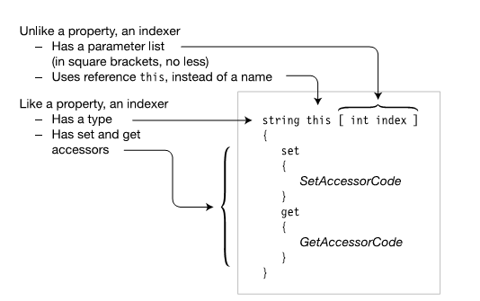
Declaring an Indexer

Slide 70
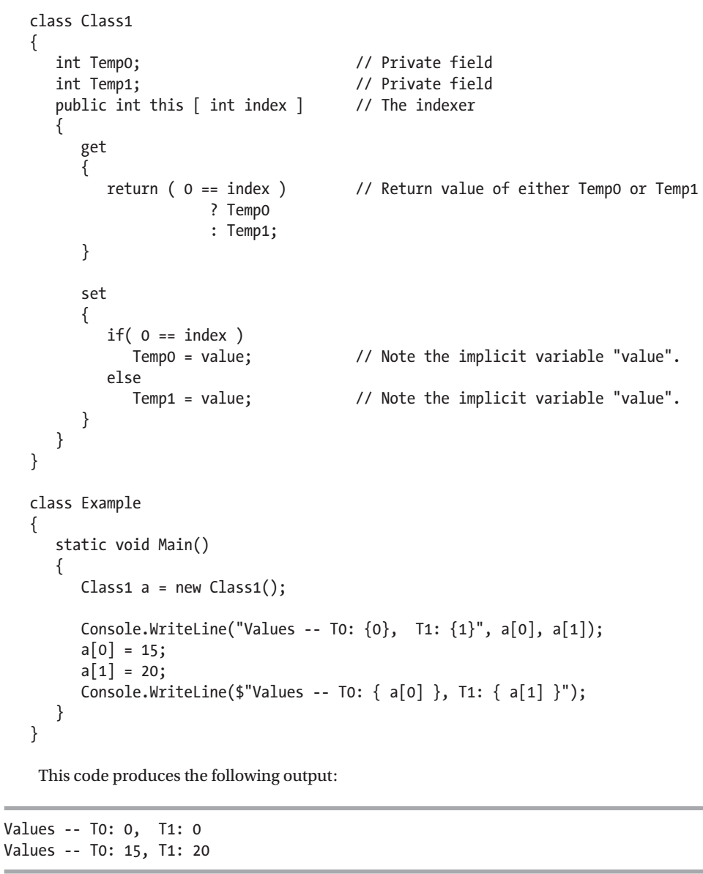
Indexers
Demo

Slide 71
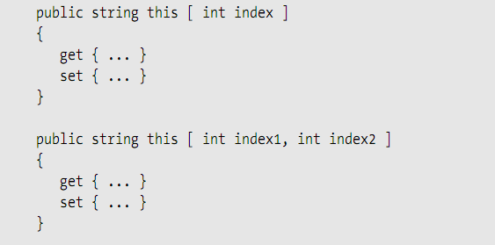
Indexer Overloading
索引器重载
A class can have more than one indexer, as long as the parameter lists are different.

Slide 72
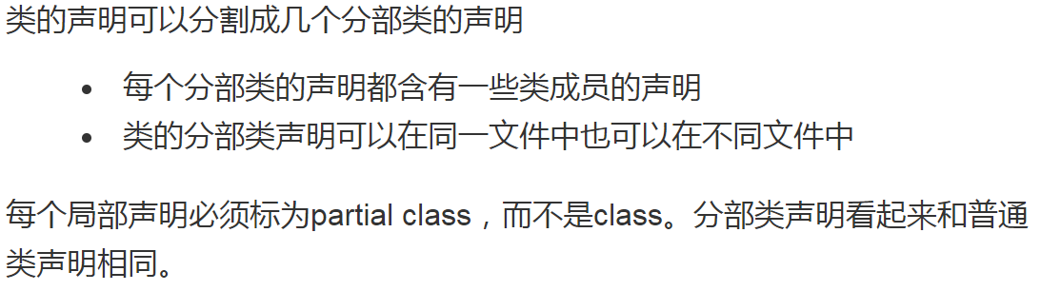
Partial Classes and Partial Types
分部类和分部类型
Each of the partial class declarations contains the declarations of some of the class members.
The partial class declarations of a class can be in the same file or in different files.

Slide 73
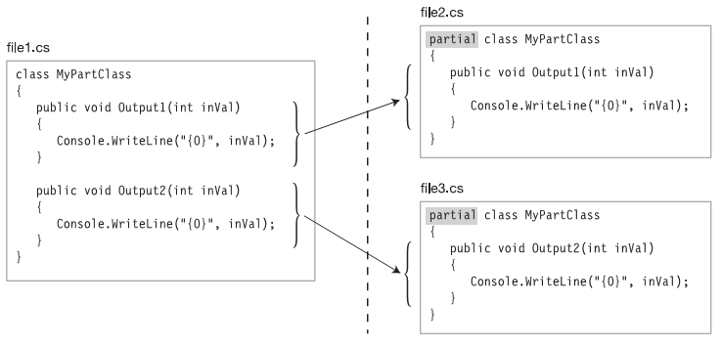
Partial Classes

Slide 74


Slide 75
Besides partial classes, you can also create two other partial types, which are the following:
• Partial structs.
• Partial interfaces.

Slide 76

Partial Methods
分部方法

Slide 77


终于
结束啦！

